Slide 1

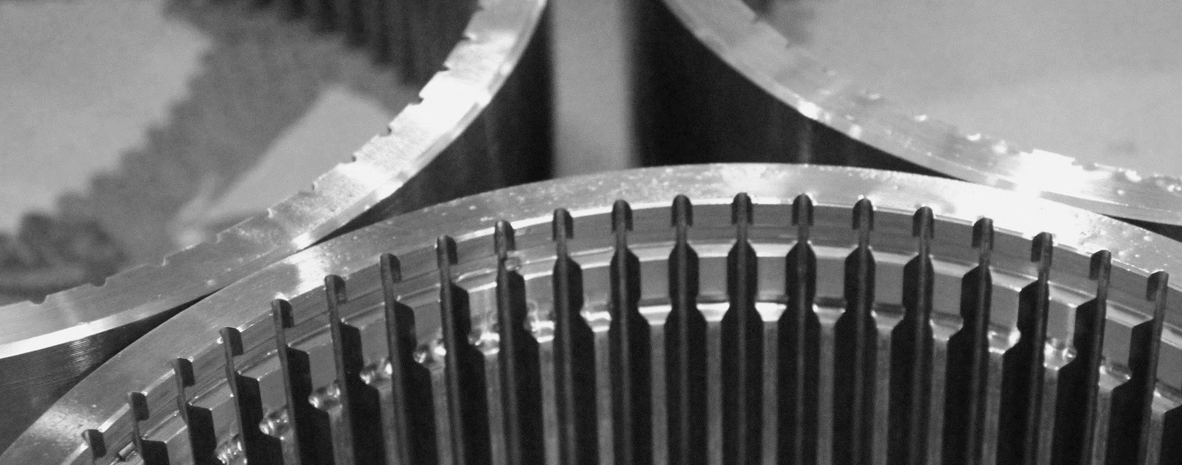
2022 AT A GLANCE
简介
WGT - Technology to Complete
Updated 07.2022

Slide 2
1 |  | WGT - Company Introduction公司简介
2 |  | Company overview & History公司概况和历史
3 |  | Products and Markets 产品和市场
4 |  | Manufacturing Capability 生产能力
5 |  | Facts & Figures 重要数据
6 |  | Contacts 联系方式
WGT - Technology to Complete

Slide 3
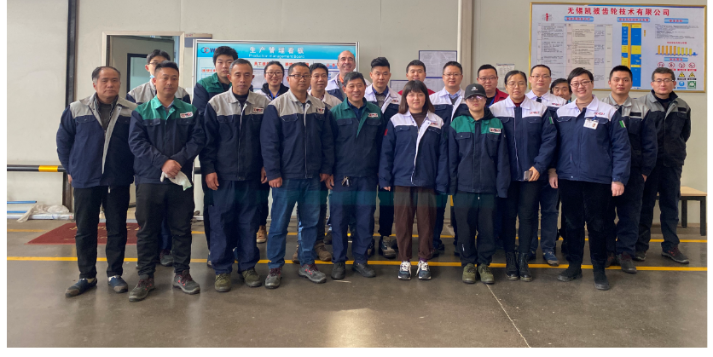
Company introduction
HISTORY IN BRIEF
历史简介
WGT (is a sister company in CAPI GROUP ITALY) a company specialized in the production of ring gears, following the entire production process for the customers.
无锡凯彼齿轮技术有限公司(意大利CAPI集团的子公司)是一家专注于生产内齿圈的加工企业，给客户提供完整的生产过程。
These components represent the heart of several mechanical applications such as:
其生产的零部件是机械传动中的核心部件，应用范围如：
Axles车桥
Transmissions传动系统
Gearbox齿轮箱
Gear reducers减速机
Power drives风电
The wide range of use is then concentrated in five main market segments:
其主要的应用领域有：
Industrial ， Construction, Agriculture, Wind Power, Automotive.
工业， 建筑，农业，风电，汽车行业等
WGT - Technology to Complete

Slide 4
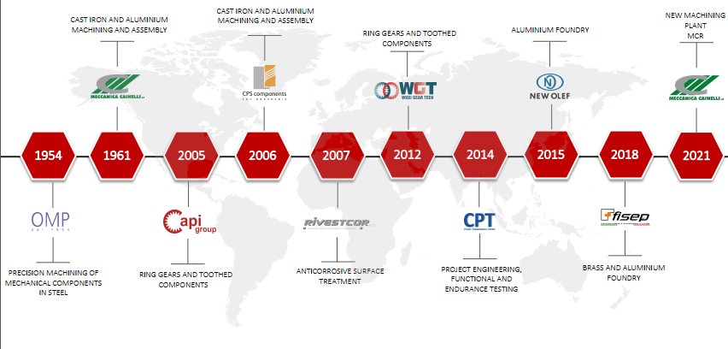
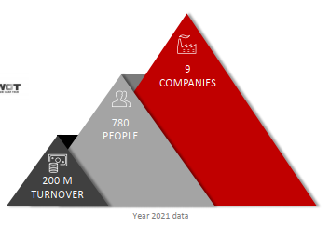
Company introduction
HISTORY IN BRIEF
历史简介
WGT - Technology to Complete

Slide 5
Company introduction
HISTORY IN BRIEF
历史简介
2021
VARINELLI broach machine 120Ton 120 吨拉床
CHONG QING CNC Hobbing 6 axis 重庆滚齿机
DOOSAN CNC turning 斗山CNC
FANUC robot automatic line for broach equipment 拉床工装-自动机械手生产线
Ultrasonic and MT not destructive tests equipment and certification
Q4. 2019
WGT relocate in Huishan district, WUXI 搬厂至惠山区
Q4 .2018
  changed the business organizaion, WGT become wholly foreign-owned comany belong CAPI group
  更改公司股份组织架构，成为独资企业
Q3 2012 – Q3 2018
  Joint venture with WEIFU group, new district, WUXI
  与威孚成立合资公司
WGT - Technology to Complete

Slide 6
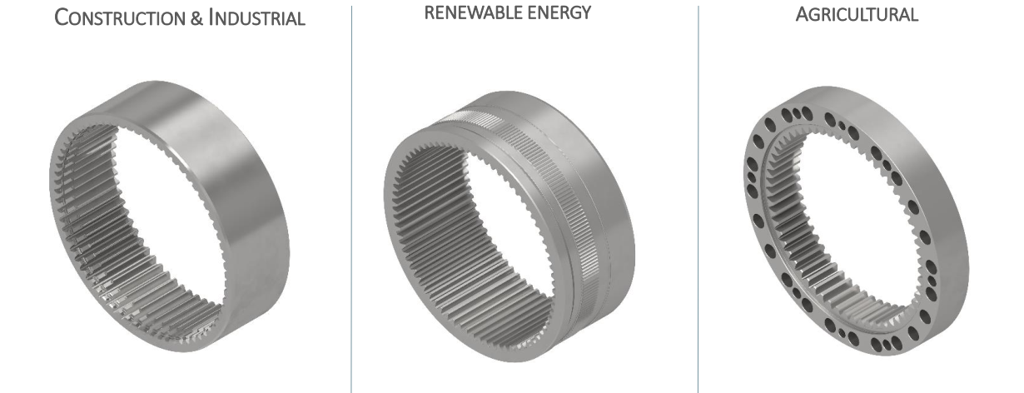
Products & markets
PRODUCTS
产品
WGT - Technology to Complete

Slide 7
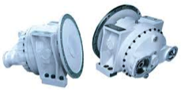
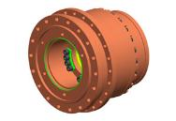
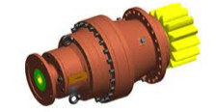

Products & markets
MARKETS AND APPLICATIONS
市场及应用
Mixing reducer
搅拌车减速机
Drive reducer
驱动减速机
Rotation reducer
回转减速机
Axle
车桥
Transmissions
传动
Agricolture
Market
农业机械
Construction
Market
建筑工程机械
Automotive
Market
汽车行业
Wind power
风电行业
WGT - Technology to Complete

Slide 8
Products & markets
PRODUCTION PROCESS
加工工艺
WGT is able to follow the fully production process:
from the blank material up to final heat treatment and controls.
WGT能够完成产品整个生产过程：从原材料毛坯到产品最终的热处理。
Shaping 插齿
Blank
毛坯
Turning
车加工
Drilling
钻孔
Hobbing
滚齿
Broaching
拉齿
H.T.
热处理
Inspection
检测
Delivery
发货
WGT - Technology to Complete

Slide 9
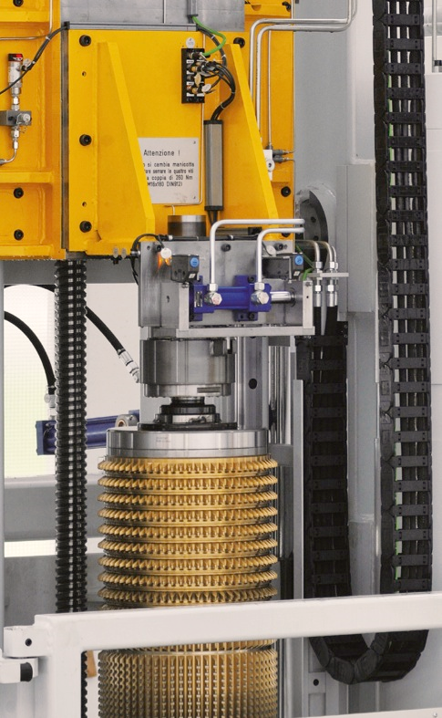
Products & markets
PRODUCTION PROCESS
加工工艺
BROACH MACHINE MAIN TECH SPEC.
BROACHING The most efficient way for producing ring gears fasten - stable quality - efficiency .
拉齿是加工齿圈的最有效、最优质的方法
      BROACHING MACHINE 160/120 TON
Quality = DIN 8
ID max ring gear ID = 450mm
Tool length = 3100 mm
Max Ring Gear h 350 mm
Annual production capability 250 .000 pcs
      160/120 吨立式拉床
精度: 达DIN 8级
内径: 最大450mm
拉刀: 长度 3100mm
齿圈最大高度: 350mm
年生产能力 250.000件
WGT - Technology to Complete

Slide 10
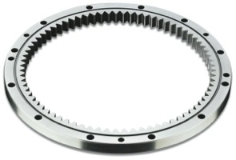
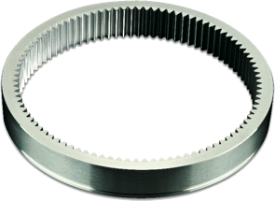
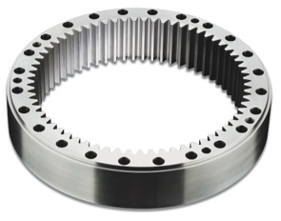
Products & markets
PRODUCTION PROCESS
加工工艺
Why choose broaching?
为什么选择拉齿
TIME SAVING
comparing with gear shaping, broaching takes up to 80% less, reducing lead time and cost.
节省时间
和传统的插齿相比，拉齿的加工时间节省了80%，这大大缩短了交货周期和成本
QUALITY CONSISTENT
broaching needs no human intervention to make regulations on the machine before or during the process, so that it keeps high product quality.
质量稳定
拉齿过程中不涉及到人为因素的干涉，从而保证了产品的高精度和质量稳定。
WGT - Technology to Complete

Slide 11
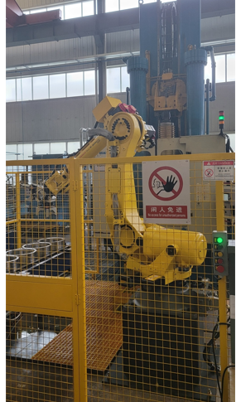
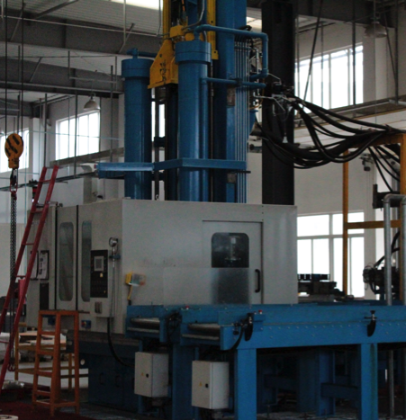
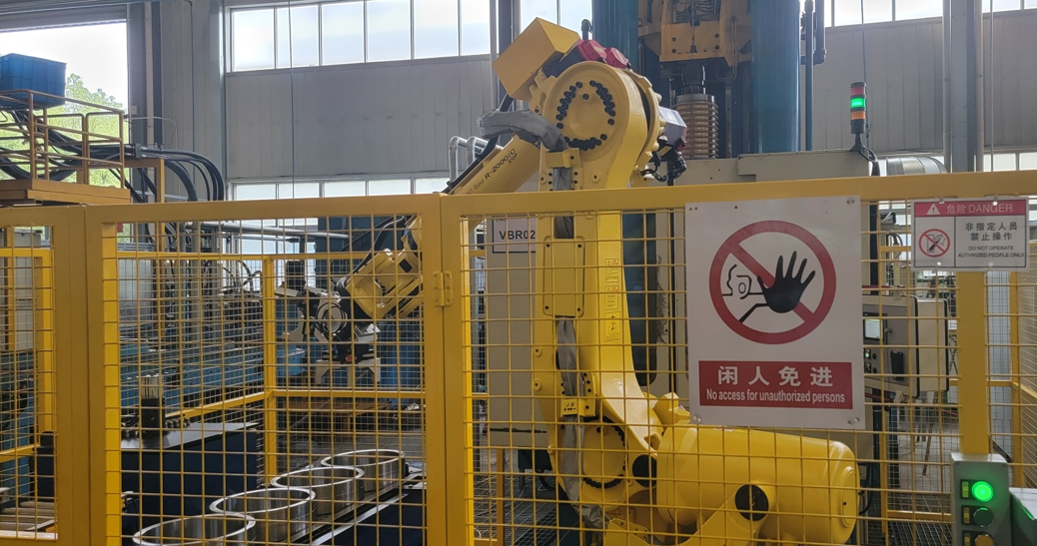
Manufacturing capability
MACHINES
机器
CNC BROACHING MACHINES 160/120 TON
160/120 吨拉床
WGT - Technology to Complete

Slide 12
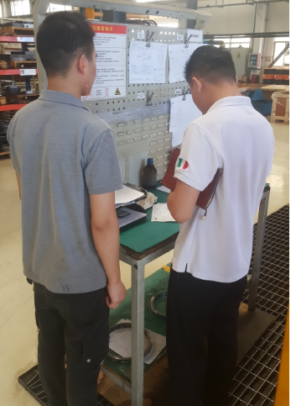
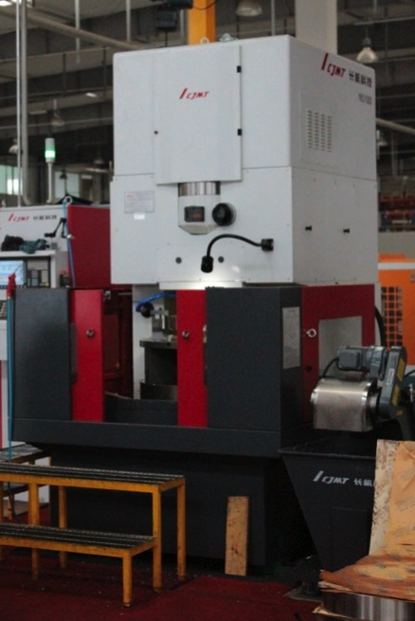
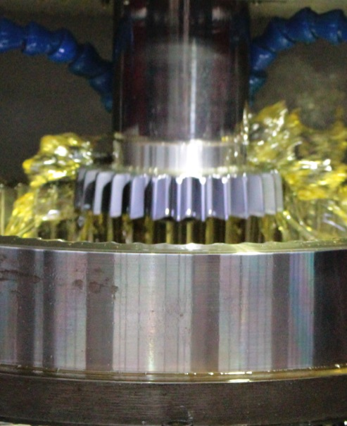
Manufacturing capability
MACHINES
机器
GEAR SHAPING MACHINE
插齿机
CNC shaping machines (3 sets)
CNC（3台）
WGT - Technology to Complete

Slide 13
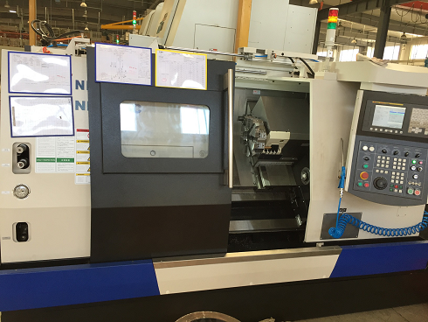
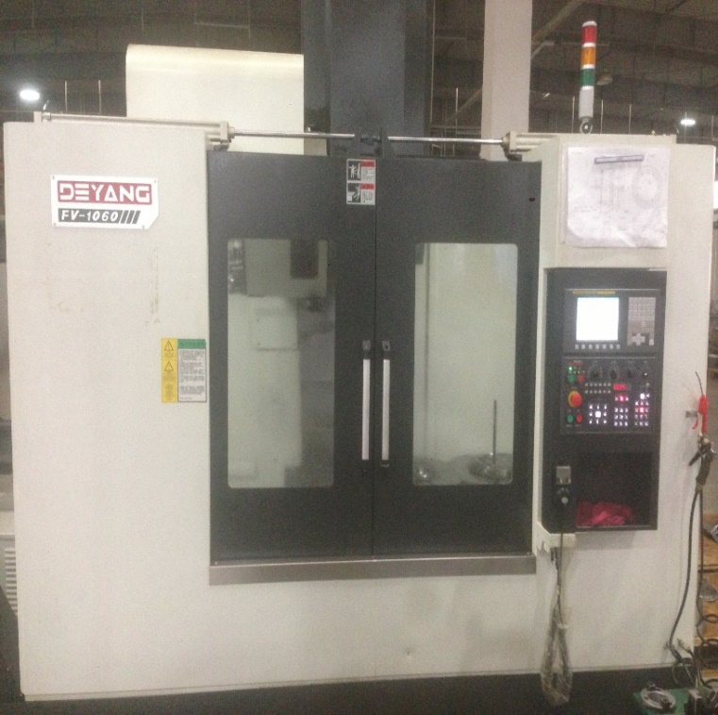
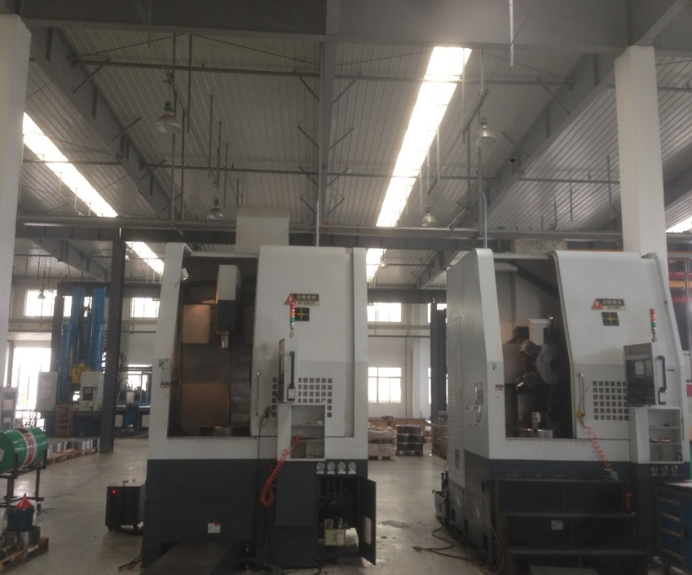
Manufacturing capability
MACHINES
机器
CNC TURNING AND DRILLING
车床和加工中心
CNC drilling machine(2 sets)
CNC 加工中心（2 台）
CNC horizontal turning machine (3 sets))
CNC卧式车床(2台）
1 set DOOSAN CNC is for hard turning 斗山（用于硬车）
CNC Vertical turning machine(2 sets)
CNC立式车床（2台）
WGT - Technology to Complete

Slide 14
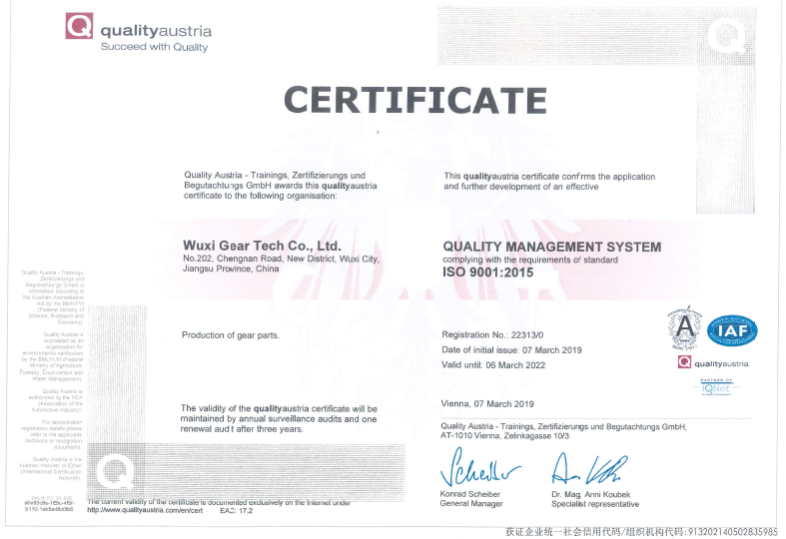
Manufactoring capability
QUALITY
质量
QUALITY MANAGMENT
质量管理
WGT can ensure the high quality
standards needed by an in-line Total
Quality Management System and
a well-developed quality department.
我们拥有高标准的质量标准，来保
证产品的质量稳定性。
Quality system ISO 9001-2015
WGT - Technology to Complete

Slide 15
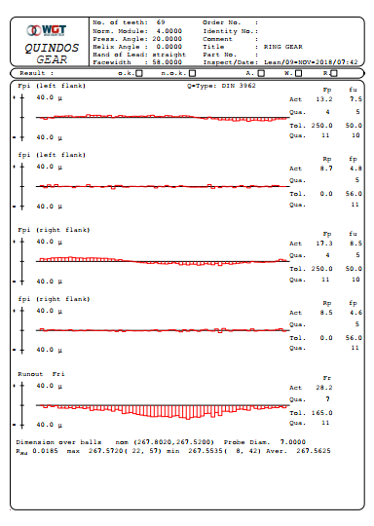
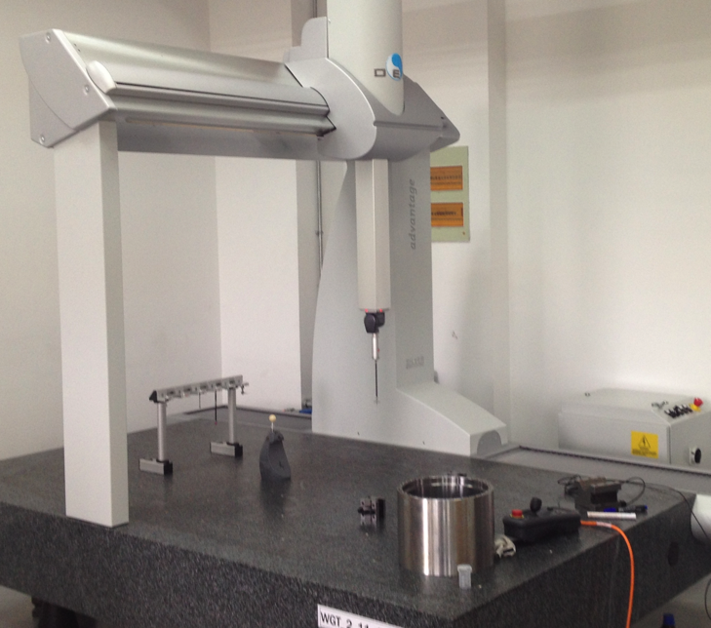
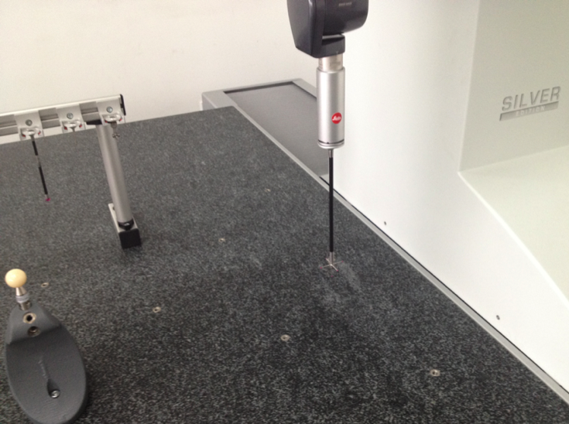
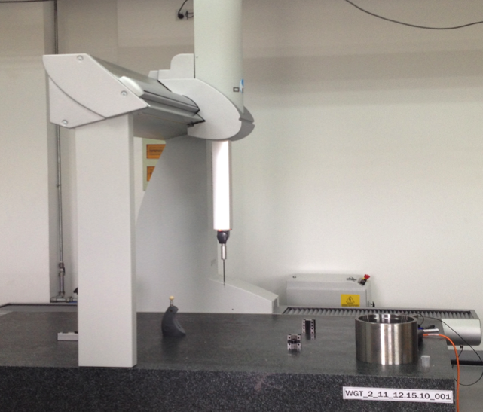
Manufactoring capability
QUALITY
质量
QUALITY MANAGMENT
质量管理
HEXAGON CMM三坐标
with gear inspection software
“Quindos7” with a scan head.
测齿软件
WGT - Technology to Complete

Slide 16
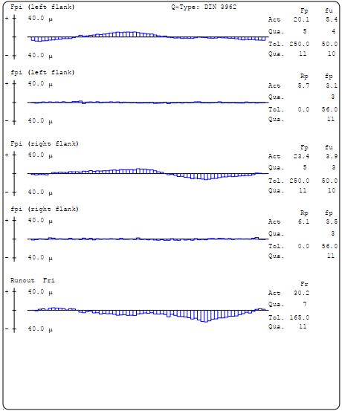
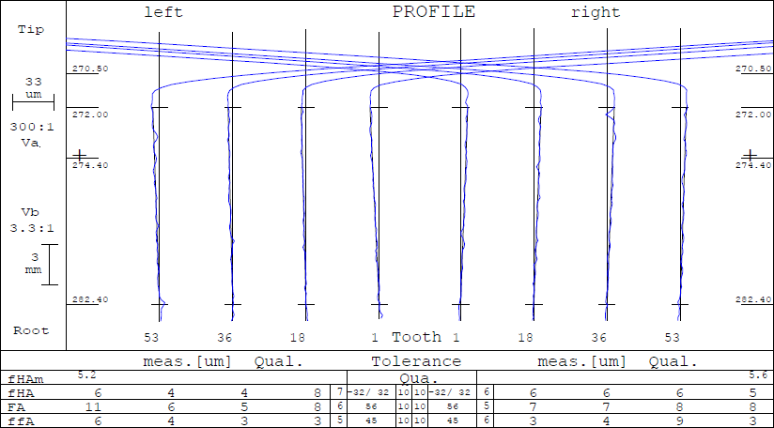
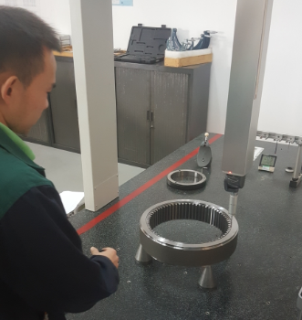
Manufactoring capability
QUALITY
质量
BROACHING QUALITY IS DIN8
拉齿精度 DIN 8
WGT - Technology to Complete

Slide 17
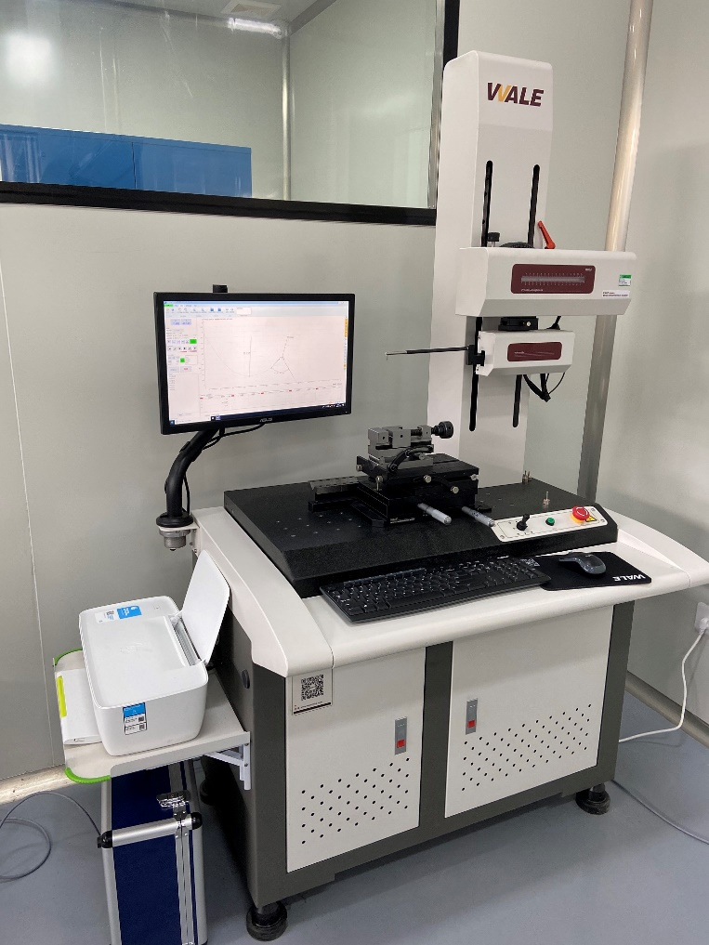
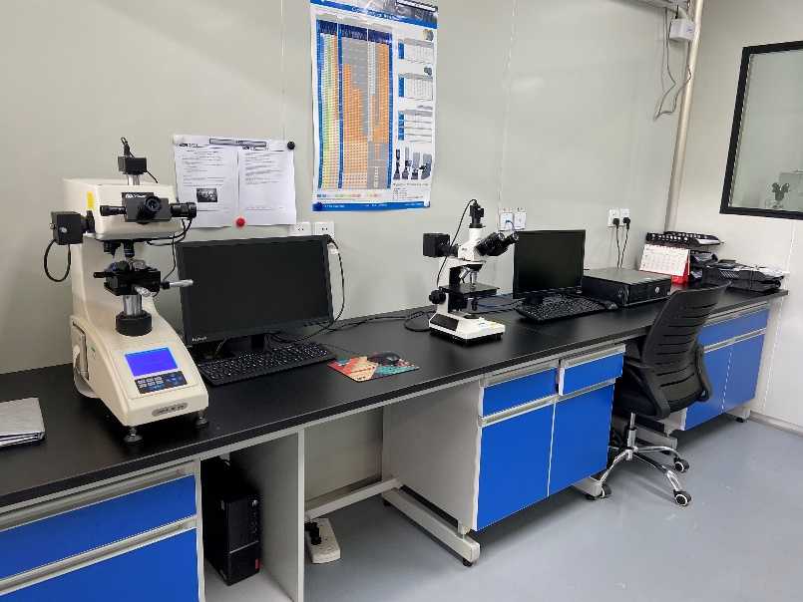
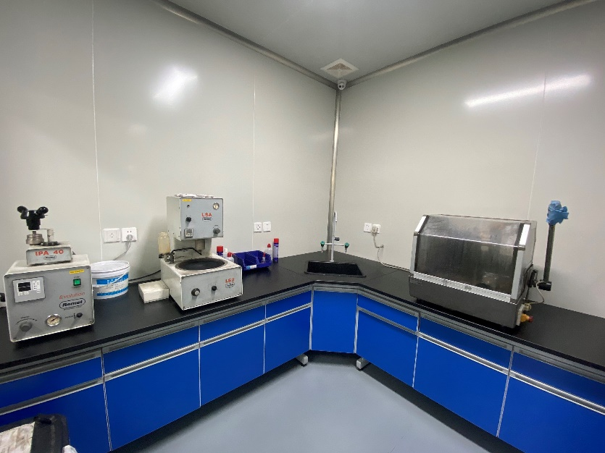
Manufactoring capability
QUALITY
质量
QUALITY MANAGMENT
质量管理
Material lab for Metallurgic and Microstructure Control, Vickers - hardness tester, profile meter 完整的材料检设备，维氏硬度仪，轮廓仪
Our staff is certified UT and MT
WGT - Technology to Complete

Slide 18
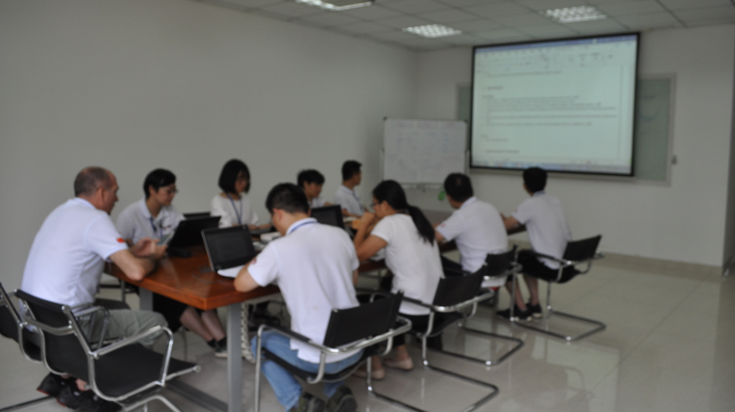
Facts & figures
FIGURES市场数据
MARKET SHARE
国内市场 出口 比例
Capacity: 35.000 pcs Ring Gears/month
WGT - Technology to Complete

Slide 19
Company introduction
MISSION AND VISION
目标和规划
OUR MISSION 我们的目标
Be the first manufacturer of ring gears in China for the local market成为国内第一家面向本土市场的齿圈专业生产厂家
OUR VISION 远景规划
As time goes by and welfare‘s demand is growing, Chinese market will require more and more hightech and quality products. Margins will fall down and the race will be between the one’s able of “state of art” processes with less human interactions (industrialization and reduction of labor cost) and best service随着时代的进步和劳动力成本的不段上涨，市场对于高科技高质量的产品需求增加，利润将会降低，竞争将会在先进的少劳力工艺和最好的服务中展开。这就要求生产制造过程尽可能地减少人力劳动，而采用更高的自动化。
To be leader in the broaching and heat treatment technology (especially gas nitriding) in the Chinese market成为国内拉齿和齿轮热处理（特别是气体氮化）的技术领军者
To become partner and strategic supplier of foreign and chinese local OEM in our markets 是国内外OEM在中国市场的合作伙伴和战略供应商
To not only supply single parts by a service to our customers, continuously improving quality, processes and price competitiveness除了提供产品和服务，也不断提升质量和加工工艺，提高价格竞争力
We need to keep the pace with technology innovation and new equipment, constant improvement should be our company policy
我们将跟上技术上的创新，采用更加先进的加工设备，不断提高是我们公司的宗旨。
WGT - Technology to Complete

Slide 20
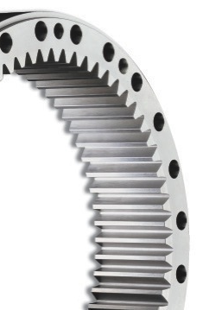
Future development
MISSION
目标
OUR MISSION IS我们的使命是
To be the ring gear Top Manufacturer in the Chinese market
成为中国市场主要的环形齿轮制造企业
Be Leader in Broaching process and Heat Treatment Technology (gas nitring) in Chinese market
成为中国发酵和热处理技术（气体渗氮）的主要技术领导者
Be Partner and Strategic Supplier abroad and in China for OEM manufacturing
成为国内外OEM制造的合作伙伴和战略供应商
Not only br supplier but also supply a comprenhensive service to our customers
不仅成为供应商，更为客户提供全面的服务
Continuosly improving in Quality, Processes and Price competition
不断提升质量，加工工艺和价格竞争力
WGT - Technology to Complete

Slide 21

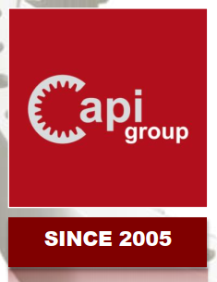

Contacts
LOCATION
位置
WGT Address:
Shengke Road, n.9,, Huishan District, Wuxi City, Jiangsu Province, China
Sales contact:
Ms. Marisa Yao
Email:
marisa.yao@wuxigeartech.com
Mobile:
+86 15052121676
QR WECHAT
WGT web. www.wuxigeartech.com
WGT Linkedin. www.linkedin.com/company/wuxi-gear-tech
Capi Group web: https://www.capigroup.it/
- Capi Group companies list -

